Slide 1

SyncShare
SyncShare is a user-friendly platform designed for secure file sharing and collaboration. Available at [http://www.syncshare.shop], it provides efficient storage, management, and file sharing capabilities. Its responsive design ensures seamless use across devices, making it perfect for both personal and professional purposes.​

Slide 2

Sprint Status Update

Slide 3

Sprint Activities
Each team member describes their work.
1
Sam
Configured and tested uploading function.
2
Rebecca
Configured file upload and Gmail SMTP.
3
Deergha
Implemented user authentication and file management.
4
Rajneet Deol
Completed Azure WordPress code design.

Slide 4
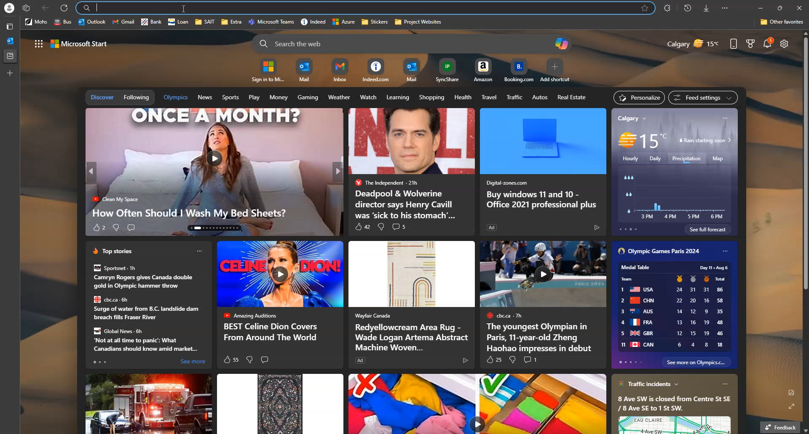

Slide 5
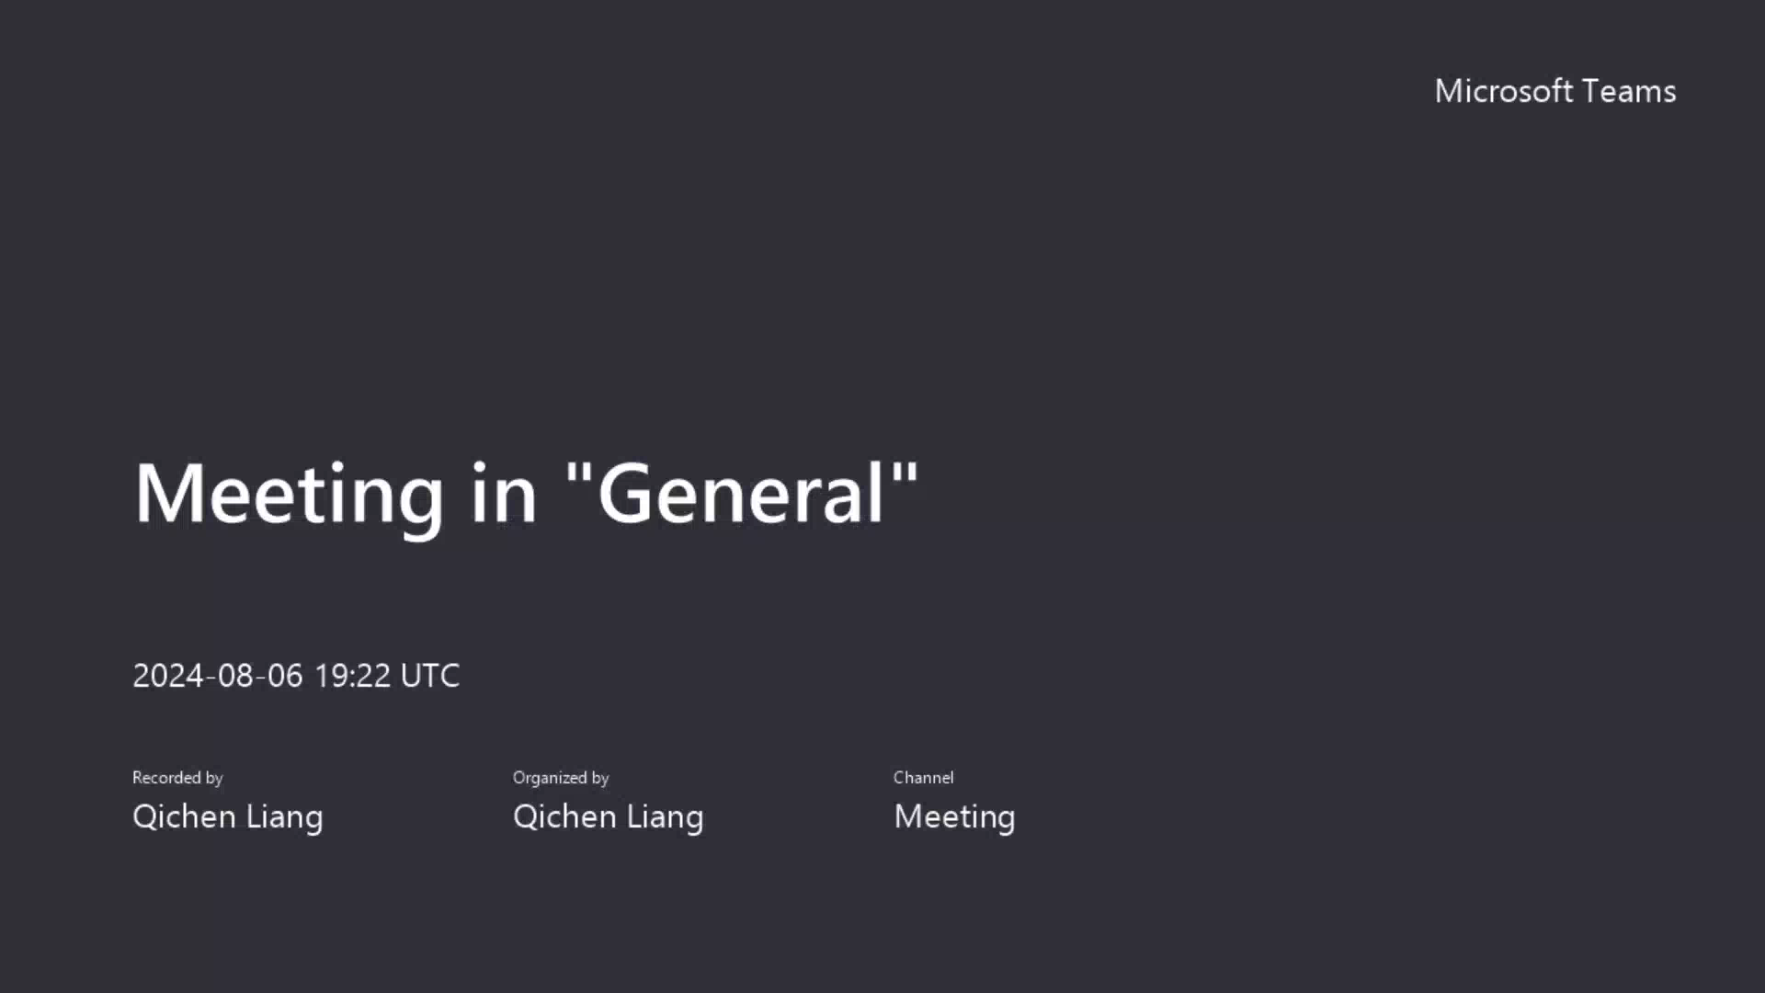

Slide 6

What We Learned
The team gained valuable skills and knowledge.
Directory and File Management
Skills in navigating and managing directories and files in a Linux environment.
Setting Up a Node.js Server
Learned how to set up and configure a Node.js server.
File Upload Handling
Configured a Flask application to handle file uploads efficiently.
Gmail SMTP Configuration
Learned how to configure Gmail as an SMTP server for sending emails.

Slide 7
What Was Delivered
The team delivered key features and functionality.
Flask Application
Frontend Design
Backend Functionality
Configured a Flask application for file uploads.
Developed a responsive and aesthetically pleasing user interface.
Set up the backend to manage file uploads.
Integrated with Gmail SMTP to send email notifications.
Configured email functionality to send uploaded files as attachments.
Implemented modal pop-ups for dynamic feedback to users.

Slide 8

What Went Well
The team achieved several successes.
1
File Upload Success
Successfully uploaded testing file to the desired location.
2
Gmail Configuration
Configured Gmail SMTP for secure email sending.
3
Team Collaboration
The team worked well together, ensuring smooth progress.
4
Problem-Solving
Issues were identified and resolved quickly.

Slide 9




What Can We Improve
The team identified areas for improvement.
Enhance File Management
Improve file organization and search functionality.
Expand User Interface
Add more features and functionalities to the user interface.
Optimize Performance
Improve the speed and efficiency of the application.

